Slide 2
Digital Forensics Lecture-15
By- Dr.subhranil Das
Assistant Professor
School of computer Science

Slide 3

Login process for the computer
1. Login into Kali Linux
2. For any forensic investigator, they will grab the hard disk for the information.
3. Analyse the hard disk computer.
4. Make a copy of that file and analyse the copy.
Reason: We don’t want to tamper the original copy.

Slide 4
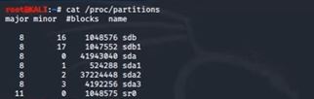
Command in Linux

Slide 5

Make a copy of the file

Slide 6
Creating hash file of the copy image

Slide 7

Change the suspect.img to suspect.hash

Slide 8
Run the suspect file

Slide 9
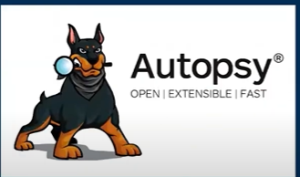
Autopsy Forensic Tool

Slide 10
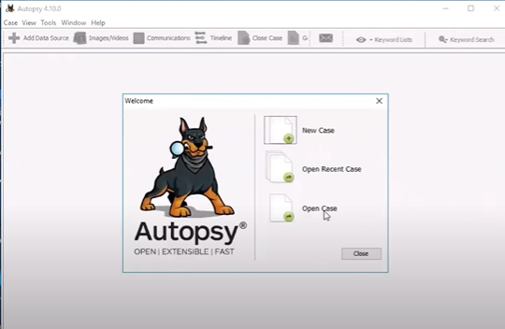
Open Case

Slide 11
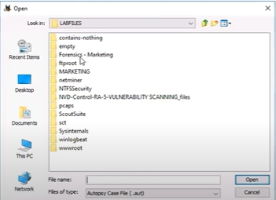
Forensics + Marketing

Slide 12
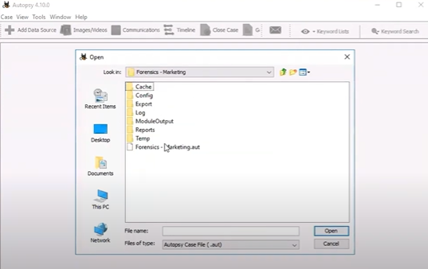
Forensics + Marketing.out file

Slide 13
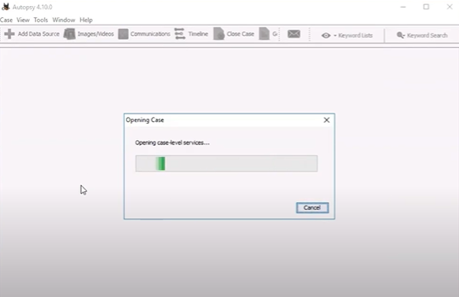
Opening Case

Slide 14
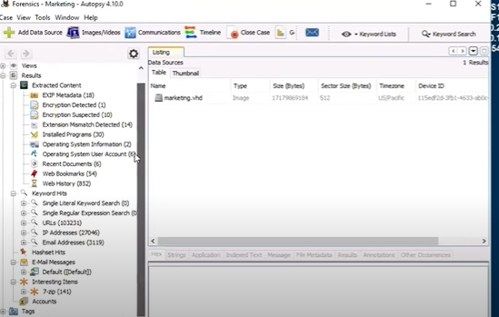
Opening the File

Slide 15
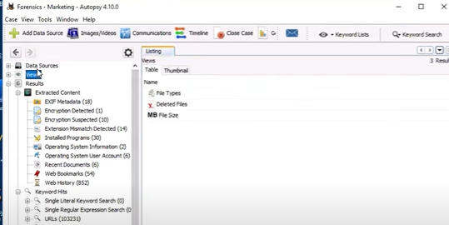
View the file

Slide 16
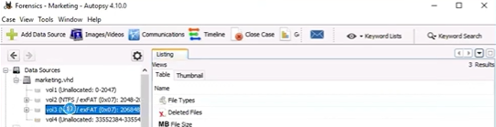
Open the FAT file

Slide 17
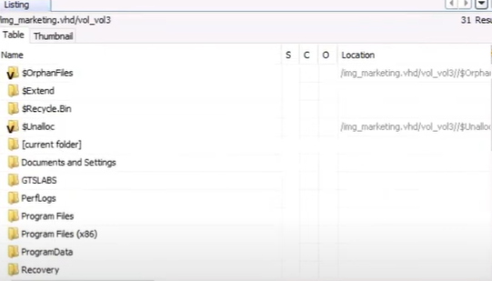
FAT File directories

Slide 18
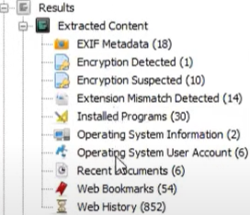
Results of FAT File

Slide 19
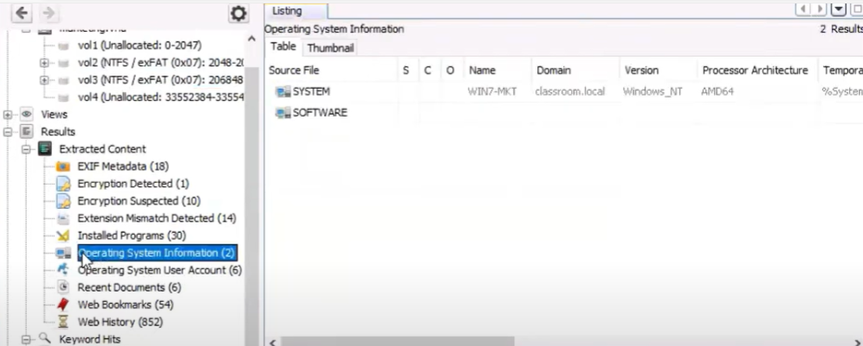
Operating System Information

Slide 20
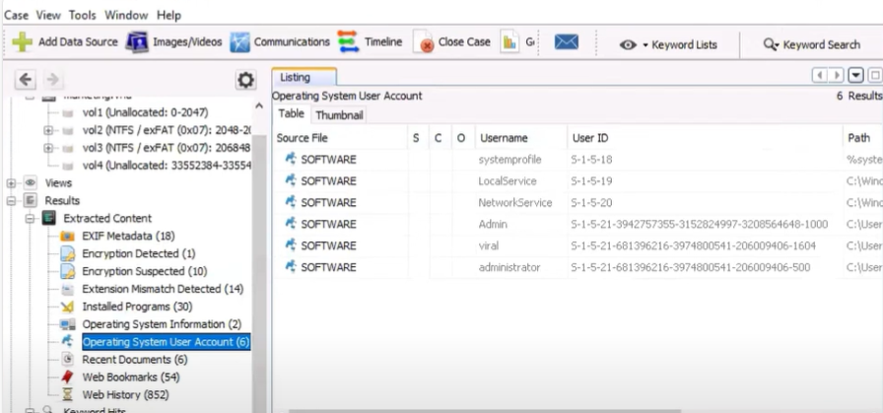
Operating System user account details

Slide 21
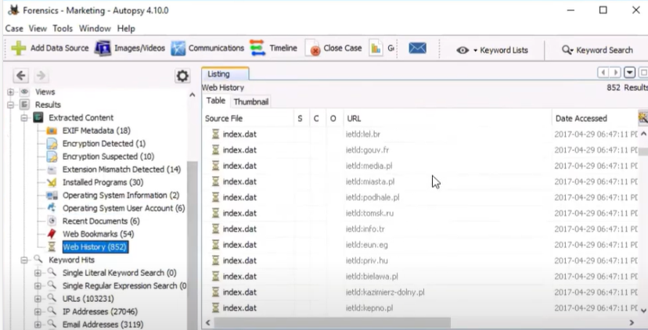
Web History Details

Slide 22
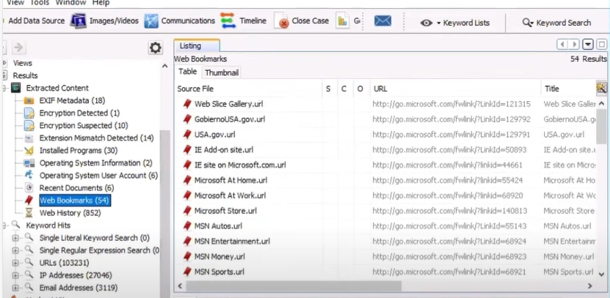
Web Bookmarks

Slide 23
Next Lecture
Hands on exercise

